Slide 1
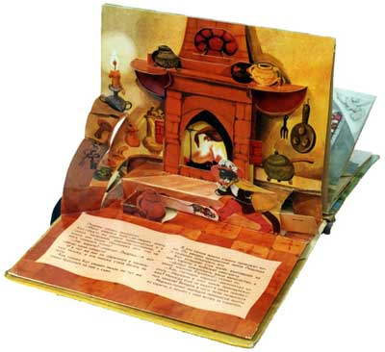
Event Handlers & Objects

Slide 2
Event Handlers
An event handler is a predefined JavaScript property of an object (in most cases an element in the document) that is used to handle an event on a Web page.
An event is something that happens when the viewer performs some sort of action, such as clicking a mouse button, moving the mouse over a link, etc.
A page loading or other similar actions are also events.
JavaScript event handlers identify when events occur and allow you to perform specific tasks, making pages interactive and more useful.

Slide 3
Event in HTML Element
To use an event handler, you can add it as an additional attribute to an HTML tag.
The only difference between an event handler “attribute” and an HTML attribute is that you can add JavaScript code inside an event handler attribute rather than just an attribute value:
<body>
<form>
<input type = "button" value = "Click Me!" onclick = "window.alert('Hi!');">
</form>
</body>
Notice that the alert command ends with a semicolon.
This enables you to add additional JavaScript code after the alert, to perform multiple actions on the click event.
Notes:
Ex 1

Slide 4
Event in HTML Element
If the code you want to use becomes really long, you may wish to put the code in a function instead.
That function can be in an external file as well.
function hi_and_bye() {
alert('Hi!');
alert('Bye!');
}
…
<body>
<form>
<input type = "button" value = "Click Me!" onclick = "hi_and_bye();" />
</form>
<script src=“ext1.js"></script>
</body>
Notes:
Ex 2

Slide 5
Event Handler in the Script Code
You can also tie an event to the element within the script code, with document.getElementById(), for example:
<body>
<form>
<input type = "button" value = "Click Me!" id = "say_hi">
</form>
<script>
function hi_and_bye() {
alert('Hi!');
alert('Bye!');
}
var hi_button = document.getElementById("say_hi");
hi_button.onclick = hi_and_bye;
// if you use hi_and_bye(); above, the function will be called straight away
</script>
</body>
Notes:
Ex 3

Slide 6
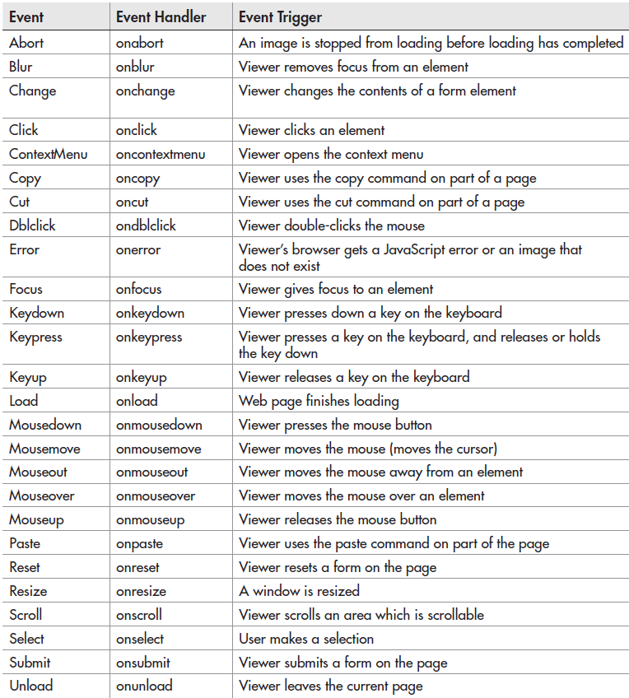

Slide 7
Example: onmouseover, onmouseout
<!DOCTYPE html>
<html>
<body>
<div onmouseover = "mOver(this);" onmouseout = "mOut(this);">
Mouse Over Me
</div> <!-- you are passing the div to the function -->
<script>
function mOver(obj){
obj.innerHTML = "Thank You";
}
function mOut(obj){
obj.innerHTML = "Mouse Over Me, Please!";
}
</script>
</body>
</html>
Notes:
Ex 4

Slide 8
“this” keyword
In JavaScript, the thing called this, is the object that "owns" the JavaScript code.
The value of this, when used in a function, is the object that "owns" the function.
The value of this, when used in an object, is the object itself.
Note that this is not a variable. It is a keyword. You cannot change the value of this.

Slide 9
Example: onmousedown, onmouseup
<!DOCTYPE html>
<html>
<body>
<div onmousedown = "mDown(this);" onmouseup = "mUp(this);" style = "background-color:#D94A38;width:90px;height:20px;padding:40px;">
Click Me
</div>
<script>
function mDown(obj) {
obj.style.backgroundColor = "#1ec5e5";
obj.innerHTML = "Release Me!";
}
function mUp(obj) {
obj.style.backgroundColor = "#D94A38";
obj.innerHTML = "Thank You!";
}
</script>
</body>
</html>
Notes:
Ex 5

Slide 10
Arrays and Objects

Slide 11
Array
An array can be created in one of three ways:
1: Regular:
var myAuthors = []; myAuthors[0] = "Stephen King"; myAuthors[1] = "J.K. Rowling"; myAuthors[2] = "James Patterson";
// Array indices start with 0.
2: Condensed:
var myAuthors = new Array(‘Stephen King’, ‘J.K. Rowling’, ‘James Patterson’); //not recommended
3: Literal:
var myAuthors = [‘Stephen King’, ‘J.K. Rowling’, ‘James Patterson’];
var top5 = [1,2,3,4,5];
var authors = [
‘Stephen King’,
‘J.K. Rowling’,
‘James Patterson’
];
Notes:
The value of array elements is obtained by referring to their index numbers.
Condensed arrays will allow for empty cells in the array.

Slide 12
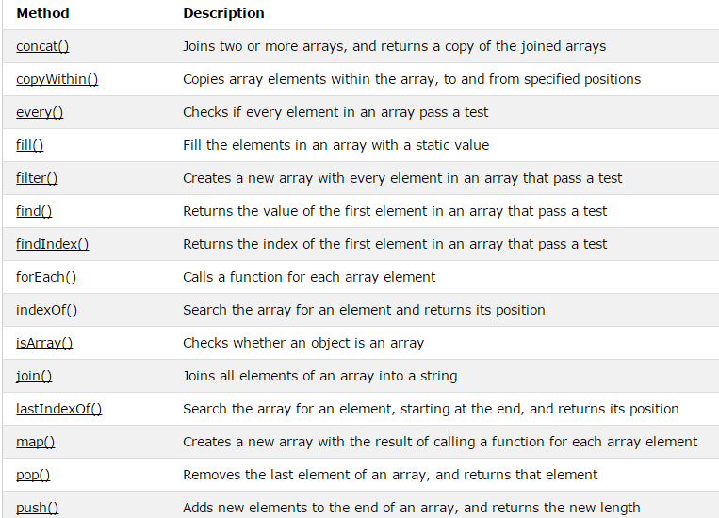
Array Properties and Methods
https://www.w3schools.com/jsref/jsref_obj_array.asp

Slide 13
Everything is an Object
In JavaScript almost everything is an object.
Even primitive datatypes (except null and undefined) can be treated as objects.
Booleans, Numbers, Strings can be objects or primitive data treated as objects.
Dates are always objects.
Maths and Regular Expressions are always objects.
Arrays are always objects.
Even Functions are always objects.

Slide 14
Different Objects in One Array
Because all JavaScript variables are objects, you can have variables of different types in the same Array.
You can have objects in an Array.
You can have functions in an Array.
You can have arrays in an Array:
myArray[0] = Date.now; myArray[1] = myFunction; myArray[2] = myCars;

Slide 15
Accessing Object Properties
Properties are the values associated with an object.
The syntax for accessing the property of an object is:
objectName.propertyName
This example uses the length property of the String object to find the length of a string:
var message = "Hello World!"; var x = message.length; // returns 12

Slide 16
Accessing Objects Methods
Methods are the actions that can be performed on objects.
You can call a method with the following syntax:
objectName.methodName()
This example uses the toUpperCase() method of the String object, to convert a text to uppercase:
var message = "Hello world!"; var x = message.toUpperCase(); // returns HELLO WORLD!

Slide 17
Creating a Direct Instance
The following example creates a new instance of an object, and adds four properties to it:
var person = new Object(); person.firstname = "John"; person.lastname = "Doe"; person.age = 50; person.eyecolor = "blue";
Alternative syntax:
var person = {firstname:"John", lastname:"Doe", age:50, eyecolor:"blue"};

Slide 18
Object Constructor
<!DOCTYPE html>
<html>
<body>
<script>
function person(firstname, lastname, age, eyecolor) {
this.firstname = firstname;
this.lastname = lastname;
this.age = age;
this.eyecolor = eyecolor;
}
var myFriend = new person("John","Doe",50,"blue");
document.write(myFriend.firstname + " is " + myFriend.age + " years old.");
</script>
</body>
</html>
//The this keyword in an object constructor does not have a value. It is only a substitute for the new object.
//The value of this will become the new object when the constructor is used to create an object.
Once you have a object constructor, you can create new instances of the object, like this:
Notes:
Ex 6

Slide 19
Adding Properties to Objects
You can add new properties to an existing object by simply giving it a value.
Assume that the person object already exists - you can then give it new properties:
person.nationality = “Swedish"; var x = person.nationality; // returns Swedish

Slide 20
Arrays versus Objects
Arrays use numbered indexes.
Objects use named indexes.
Arrays are a special kind of objects, with numbered indexes.
When to Use Arrays? When to use Objects?
JavaScript does not support associative arrays (maps, dictionaries).
You should use objects when you want the element names to be strings (text).
You should use arrays when you want the element names to be numbers.
Notes:
Associative arrays - arrays that use named keys that you assign to them - a collection of (key, value) pairs.

Slide 21
Passing Objects as Arguments
JavaScript is always passed by value, but for objects that value of the variable is a reference.
Because of this, when you pass an object and change its properties, those changes persist outside of the function.
This makes it look like it’s pass by reference.
But if you actually change the value of the object variable, you will see that the change does not persist, proving it's really pass by value.

Slide 22
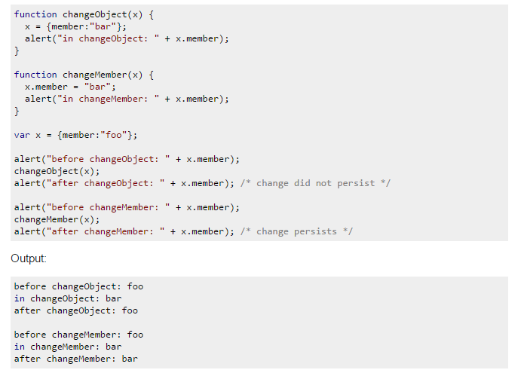
Passing Objects as Arguments

Slide 23
JavaScript for...in Loop
The code inside the for...in loop will be executed once for each property of the object:
<!DOCTYPE html>
<html>
<body>
<p>Click the button to loop through the properties of an object named "person".</p>
<button onclick = "myFunction()">Try it</button>
<p id = "demo"></p>
<script>
function myFunction(){
var txt = "";
var person = { fname:"John", lname:"Doe", age:25 };
for (var x in person){
txt = txt + “ " + person[x];
}
document.getElementById("demo").innerHTML = txt;
}
</script>
</body>
</html>
Notes:
Ex 7

Slide 24
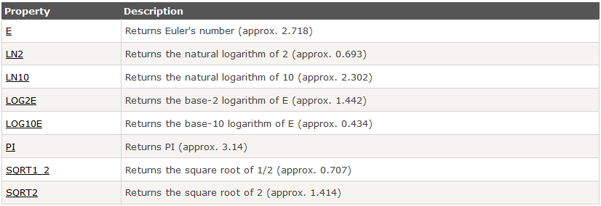
Math Object Properties
The Math object allows you to perform mathematical tasks.
All properties/methods of Math can be called by using Math as an object, without creating it, e.g. Math.PI

Slide 25
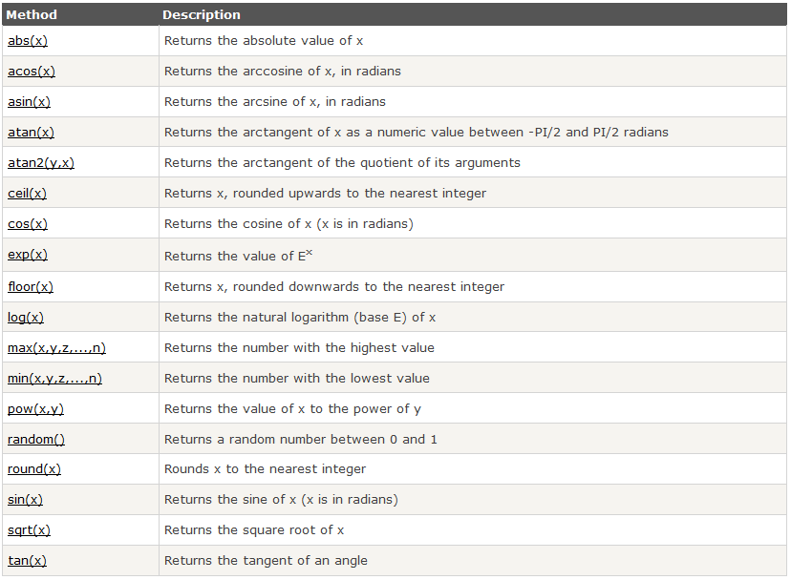
Math Object Methods

